Slide 1
Carbon Stitch
a way to turn noisy CO₂ measurements into decision-grade site totals
Notes:
Hi everyone, I’m Mat. Our project is Carbon Stitch — we turn noisy CO₂ measurements into one decision-grade site total.

Slide 2
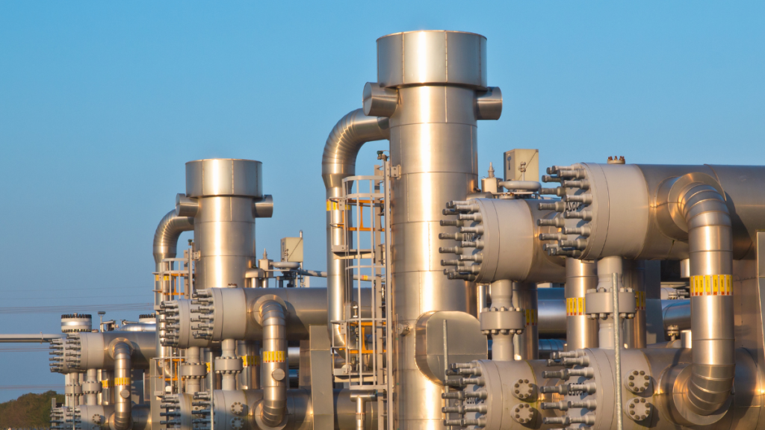
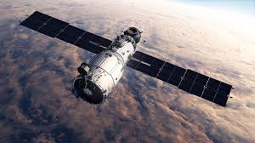
The Problem – Measuring CO2 is hard
Bottom-up (meters, flow rates): cheaper than metering every stack, but sensors drift, coverage is patchy, and wind effects skew readings.
Top-down (satellites/airborne): great coverage, but clouds, wind and retrieval noise mean big error bars.
Notes:
The problem. Sites have two imperfect views. Bottom-up numbers from meters and factors are patchy and drift; top-down satellite/airborne data sees everything but has big error bars. You end up with numbers you can compute, but not always defend.

Slide 3
Carbon Stitch
Carbon Stitch blends bottom-up and top-down using inverse-variance weighting
In English: we trust each source in proportion to its certainty and produce one reconciled site rate with smaller error bars
Notes:
Our solution. We blend both views using inverse-variance weighting — in plain English: we trust each source in proportion to its certainty. The output is one stitched site rate with smaller error bars and a transparent audit trail

Slide 4
Why this Matters
Money: Tighter uncertainty → tighter carbon accruals and fewer site visits.
Resilience: When a meter fails, satellites keep coverage; when a plume looks odd, meters keep you grounded.
Trust: One reconciled number that operators, regulators, investors and communities can all stand behind.

Slide 5
Data Sources
Carbon Mapper – Plume mass, shape, and wind data
Internal measurements
time_utc | asset_id | asset_type | activity_basis | activity_value | method | ef_units | ef_value | assumed_heat_rate_GJ_per_MWh | prior_tph | sigma_prior_rel | site_prior_tph
2025-09-26T08:00:00Z | GT1 | stack | electric_load_MW | 180 | factor | kgCO2/GJ | 56.1 | 7 | 36 | 0.25 | 100
2025-09-26T08:00:00Z | GT2 | stack | electric_load_MW | 180 | factor | kgCO2/GJ | 56.1 | 7 | 32 | 0.25 | 100
2025-09-26T08:00:00Z | AUX_BOILER1 | boiler | thermal_load_MWth | 30 | factor | kgCO2/GJ | 56.1 |  | 20 | 0.25 | 100
2025-09-26T08:00:00Z | FLARE_NORTH | flare | event |  | factor | kgCO2/GJ | 56.1 |  | 12 | 0.3 | 100
Notes:
Not so important
I just want to outline an example of internal data which has assets, flow rates, and the uncertainty

Slide 6
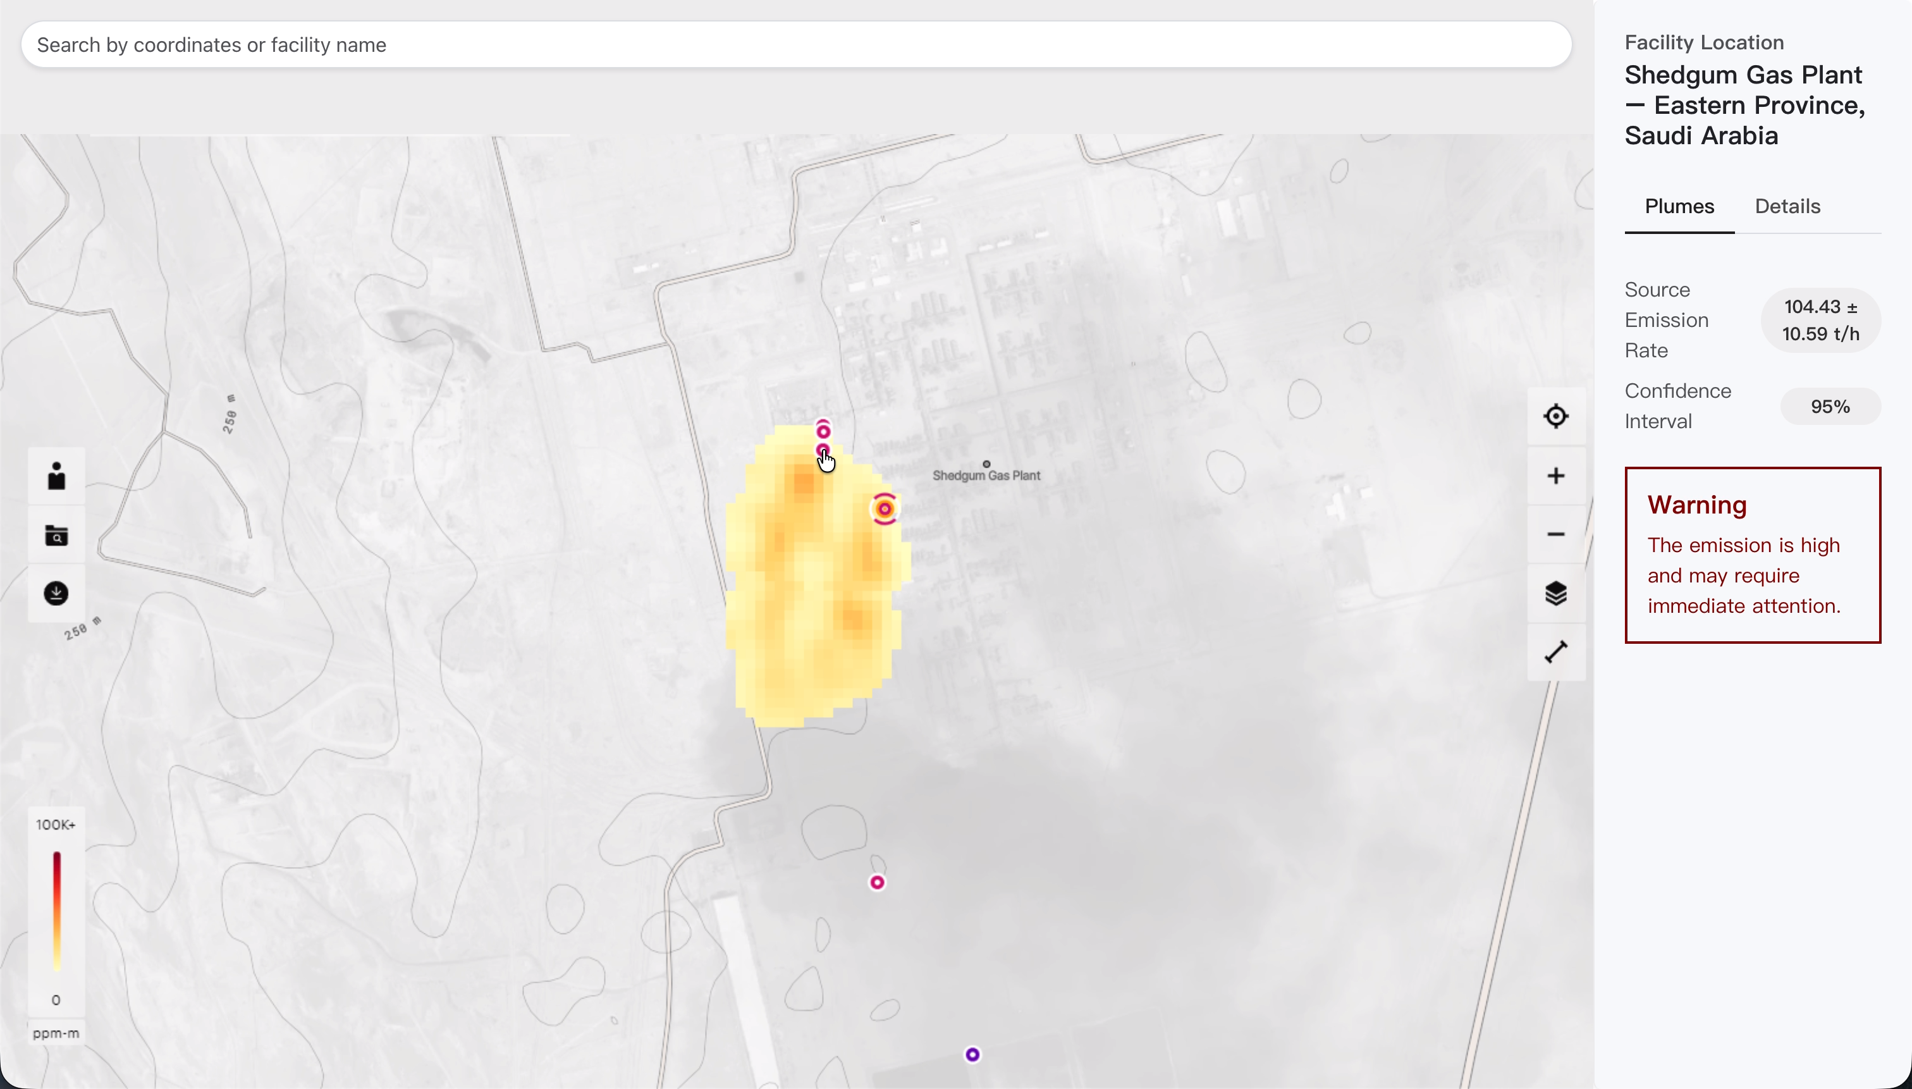
What We Built
Notes:
A map dashboard over an Aramco facility (demo data). You’ll see four CO₂ plumes; together they sum to 111.5 t/h with their 1σ uncertainties.
A blender that takes those two inputs and produces a stitched result of 104.43 ± 10.59 t/h (1σ), with a clear 95% band Top-down: for each plume we take the published rate (kg/h) and 1σ uncertainty. (Under the hood that rate comes from plume mass + wind + geometry.) Bottom-up: we load per-asset t/h and apply a conservative relative uncertainty

Slide 7
How Did We use the Data?
Top Approach
Get Plume Shape
Project to Wind Vector
Calculate Source Flow Rate
Bayesian Blend
Final Figure
Bottom Approach
Get Internal Measurements
Sum Flow Rates

Slide 8

Plume → Wind Vector Projection
Wind Direction
Cloud Length

Slide 9
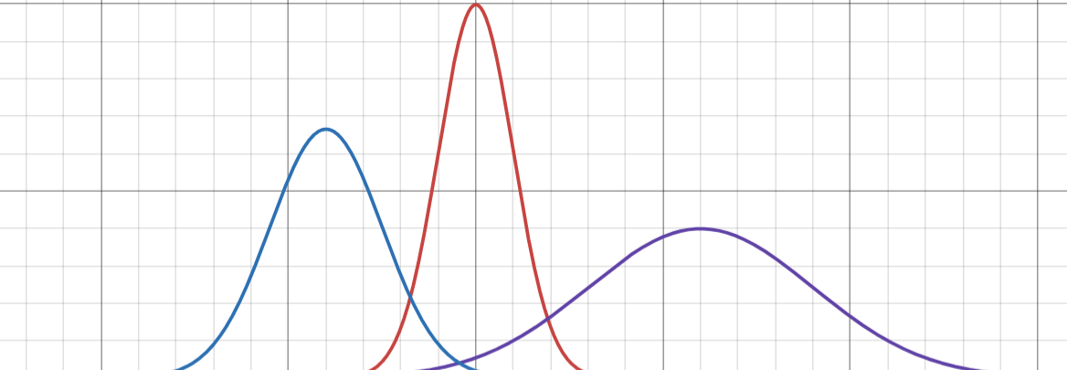

Bayesian Inverse Variance Blend
Typical Error
Blended Value
Bottom-Up Value
Top-Down Value
New Error
$Emission Rate=\frac{E_{S}}{σ_{S}^{2}}+\frac{E_{P}}{σ_{P}^{2}}÷\frac{1}{σ_{S}^{2}}+\frac{1}{σ_{P}^{2}}$

Slide 10
Impact
Reduce Uncertainty by 30-50% compared to either source alone
Simulated guidance
Stakeholder trust: one reconciled figure for operators, regulators, lenders, and communities
Notes:
Smaller error bars (-30–50%) vs either source alone → a decision-grade KPI instead of dueling estimates.
Scalable coverage: when meters fail, satellites keep you covered; when scenes are low-quality, meters anchor the estimate.
If you can cut uncertainty, you can cut cost.
So instead of choosing between imperfect bottom-up or top-down, Carbon Stitch combines them mathematically—weighting each by its uncertainty—to deliver a single site-level emissions rate with smaller error bars and higher credibility

